Slide 1

Accessibility in Game Development Tools
Cameron Dawes
22019386
MID-POINT REVIEW

Slide 2

Agenda
Project Introduction
Project Aim
Project Objectives
Literature Review
Research Methodology
Development Phase Plans
Testing Phase Plans
Gantt Chart of Future Weeks
Questions

Slide 3


Introduction
This project investigates the usability and accessibility in game development tools and the short falls of existing research into the area. The aim is to show a positive reaction to the development of the tools usability and prove that the there is value in the use of resources to improve it.

Slide 4
Aim & Objectives
Aim
Objectives
Investigate the current state of usability and accessibility in existing game development tools and research.
Design and develop a tool that prioritizes usability and accessibility.
Conduct user testing to evaluate the effectiveness of the tool, gathering feedback on how the focus on usability and accessibility impacts their experience.
Analyse and critique existing game development tools.
Gather user feedback through surveys to identify pain points in current tools and software.
Define design criteria for the tool's usability and accessibility.
Prototype and develop a game development tool using the criteria.
Iterate the tool based on user feedback from tool testing.
Assess users on the final tool's usability and accessibility using a combination of qualitive and quantitative data.
Analyse the data to see the affects of a focus on usability and accessibility affects users satisfaction and productivity.

Slide 5



Literature Review
There are three key research areas within my project, Accessibility in Software Development, Usability in Development Tools, and the Evaluation of Game Development Tools. In software there is a lack of expertise and ability among developers to address usability and accessibility concerns thus accessibility remains an afterthought in software with limited implementation. Usability is the core of a development tools success and adoption. A lack of it leads to a slower learning experience and waste of development time. Ultimately the implementation of accessibility in game development tools are at the core of research and evaluating others approaches and results give meaningful information and experience that can be used to further my implementation and compare results and findings to prove the validity of the conclusion.

Slide 6
Literature Review
Accessibility in Software
Rohan Patel, Pedro Breton, Catherine M. Baker, Yasmine N. El-Glaly, and Kristen Shinohara. 2020. Why Software is Not Accessible: Technology Professionals' Perspectives and Challenges
Cynthia Putnam, Kathryn Wozniak, Mary Jo Zefeldt, Jinghui Cheng, Morgan Caputo, and Carl Duffield. 2012. How do professionals who create computing technologies consider accessibility?
Rohan Patel et al. (2020) analyse the lack of accessibility in software and identifies two main factors, developers lack of expertise and confidence in implementing accessibility, and the prioritization of releasing software and features quickly over furthering of accessibility features.
These findings align with Putnam et al.’s (2012) research which surveyed UX and HCI professionals. Their study showed 70% of developers considered accessibility in some form, though the interviews highlighted that many felt they weren’t doing enough. Additionally, the 19% who said that accessibility should be prioritized more relate the lack of focus on accessibility to company priorities.

Slide 7
Literature Review
Usability in Tools
T. Weber, A. Zoitl and H. Hußmann, "Usability of Development Tools: A CASE-Study,“ 2019
Weber et al.(2019) analyse the state of usability in development tools. They states that these tools are meant to “support and enable developers.” However, they argue that poor usability acts as an obstacle to adoption, and acts as a barrier to the efficient use of the tool. They highlights that a lack of usability not only lowers productivity but also reduces the comprehension of the tool, which potentially negates the benefit of using the tool. They then focus their efforts to improve the usability of their chosen tool (4diac IDE) using their findings. These efforts were met with appreciation and engagement in the development and improvement of said accessibility.

Slide 8
Literature Review
Evaluation of Game Development Tools
S. Blomqvist, B. Detterfelt, “Real Time Integrated Tools for Video Game Development: a usability study”, 2020
Blomqvist (2020) aimed to create a game engine integrated 3D shader for 2D environments. His motivation originated from the observation that external tools are often overly complex, attempting to accommodate a wide range of needs to maximize adoption though this wide scope increases complexity. During development, Blomqvist identified that it was most effective to start each sprint addressing the usability issues highlighted in his questionnaires prior to the implementation of new features. He developed in sprints which allowed for incremental improvements to both features and usability which enabled the creation and implementation of higher quality and more robust solutions compared to the implementation of everything and iterating afterward.
C. Volioti, V. Martsis, A. Ampatzoglou, E. Keramopoulos and A. Chatzigeorgiou, "Codeless3D: Design and Usability Evaluation of a Low-Code Tool for 3D Game Generation,“ 2024
Violioti et al. (2024) took a different approach in their development of a “Low-Code Tool for 3D Game Generation”, which allows a user to create basic games with no coding experience. Unlike Blomqvist they developed the tool before surveying users. This approach means potentially faster development but addressing usability issues in core components could be challenging compared to iterative development. While their usability evaluations were promising and the tool received positive feedback, it achieved a slightly lower SUS score than Blomqvist’s project. Additionally, feedback revealed request for features that could have been implemented during development if an iterative approach had been used. Instead, these features will need to be added in future updates

Slide 9
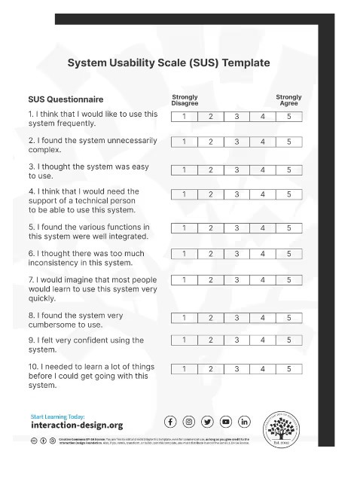
Research Methodology
I Intend to use a mix of quantitative and qualitative research methods.
Quantitative:
SUS Questionnaire
Comparison between two Images with a choice
Qualitative:
Direct open-ended questions to the participant
How would they improve it
Was there anything that annoyed you while using the tool
Are there features you would add

Slide 10
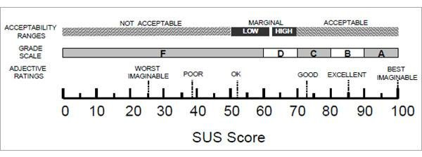
Research Methodology
Reasons for the SUS questionnaire at the core or the study:
Widely implemented with years of use.
Adjacent studies use it (more comparable results)
Due to the Wide use we can be confident using the SUS score to evaluate the usability of the tool

Slide 11
Timeline Overview
October 2024
Project pitch.
Initial meetings.
Ethics.
Begin literature review.
November 2024
Work through the literature review.
Begin to prep for the mid-point viva.
December 2024
Initial surveys.
Plan for development (design and features).
Start Development.
Send out surveys evaluating usability and improvements.
January 2025
February 2025
Finalise development.
More usability surveys.
Begin testing phase.
Final user opinion and SUS score.
Gather data and evaluate.
Final write up.
Artefact polish.
Submit entire project.
Begin to prep for the final viva.
March 2025
Present final Viva.
Await grade.

Slide 12
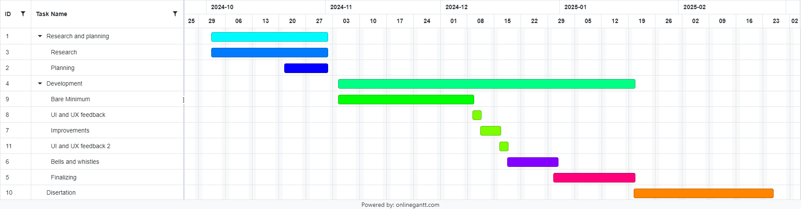
Gantt Chart

Slide 13

THANK YOU// QUESTIONS
Cameron Dawes
22019386
d019386m@student.staff.ac.uk

